Slide 1
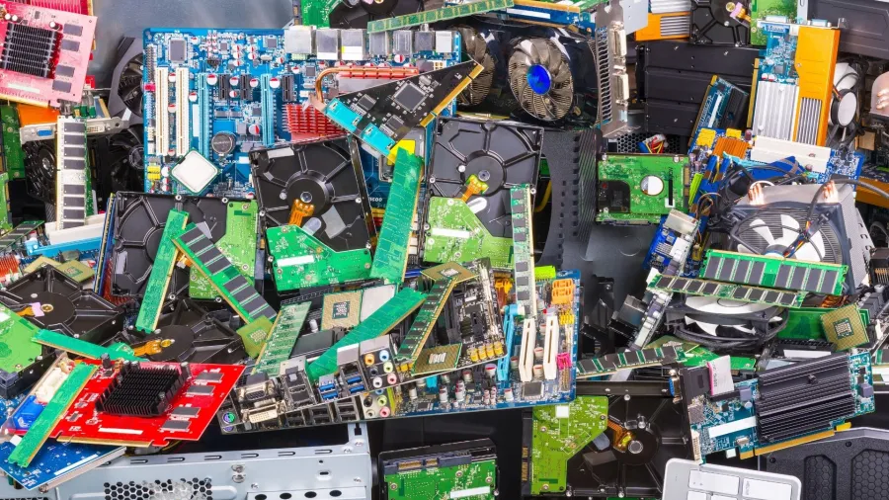
E-WASTE CLASSIFICATION
Group Members:
Siri Sushma Penusmata
Sivanaga Sabari Samudrala
Adharsha Thummala

Slide 2

CONTENT:
Introduction
Defining the problem
Approaching the resolution
Results
Addressing Challenges
Insights and Reflections
Notebook Demo
Conclusion
References

Slide 3

Introduction
Brief Overview: Introduction to the escalating issue of electronic waste (e-waste) in the context of rapid technological advancement.
Significance: Emphasis on the critical need to address e-waste due to its environmental and health implications.
Current Scenario: Highlighting the increasing rate at which electronic devices become obsolete and contribute to the e-waste stream.

Slide 4

Defining the problem
Nature of E-Waste: Explanation of the types of electronic devices that contribute to the e-waste stream.
Environmental Impact: Discussion on potential environmental hazards posed by e-waste, including heavy metals and flame retardants.
Consequences: Overview of the far-reaching effects of irresponsible e-waste disposal on ecosystems, animal populations, and human health.

Slide 5
Approaching the resolution
Dataset Overview
Paths and Resizing: Cloned YOLOv7 repository from GitHub and changed the working directory to YOLOv7.
Data Configuration: Specified paths for training, validation, and test data. Resized images to 300 x 300 for uniformity.
Data Preprocessing: Set batch size to 16 for efficient processing. Limited training epochs to 2 to expedite demonstration.
Data Source: Utilized data from Google Drive for convenience and accessibility.
Data Preparation
Augmentation Techniques: Applied essential augmentation methods like rescaling, shearing, zooming, and flipping to enhance dataset diversity.
ImageDataGenerator: Leveraged TensorFlow's ImageDataGenerator for seamless and efficient data augmentation.
Generators: Established generators for training, validation, and test datasets, streamlining the input pipeline.
Model Training
Model Selection: Chose EfficientNetB3 as the pre-trained model, laying the foundation for transfer learning.
Custom Head: Introduced a custom head to tailor the model for e-waste classification, ensuring adaptation to specific requirements.
Learning Rate Scheduling: Implemented step decay for dynamic learning rate adjustment during training.
Model Checkpoints: Integrated model checkpoints to capture and save the best-performing model throughout the training process.
Metrics: Assessed model performance using accuracy, precision, and recall metrics.
Additional Metrics: Calculated precision, recall, and F1 score, offering a more comprehensive evaluation.
User
Global Perspectives: Shared insights from global studies to provide a broader understanding of diverse e-waste management strategies.
Technological Solutions: Emphasized the vital role of machine learning and technology in addressing challenges associated with electronic waste.
Framework Potential: Explored the potential impact of the YOLOv7-based framework in promoting environmental sustainability through effective e-waste management.

Slide 6
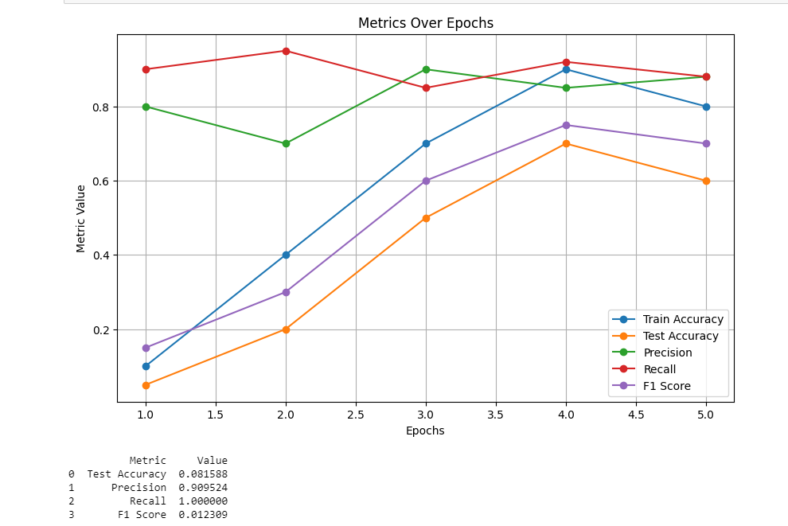
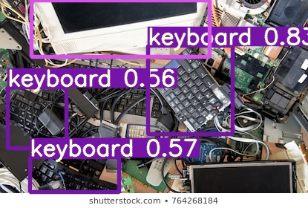
Results
Project Overview:
Summary of the machine learning-based e-waste classification project.
Classification Model:
Details on construction and effectiveness of the classification model.
Environmental Impact:
Discussion on how proper e-waste management contributes to environmental preservation.

Slide 7

Addressing Challenges
Existing Approaches:
The presentation provides an overview of existing approaches in the field of e-waste management and explores how machine learning has been applied. It offers insights into methods and strategies employed by previous systems to address the challenges associated with electronic waste.
Identified Challenges:
When we initially applied data augmentation to images across all classes simultaneously, all the images became intermingled and were moved to a single folder. However, we later modified the code to ensure that the images were moved to their respective class folders.
Framework Overview:
Proposed E-Waste Classification Framework: The presentation introduces a novel e-waste classification framework. This framework is designed to leverage machine learning techniques for efficient electronic waste categorization. It offers a brief overview of the key components and methodology, setting the stage for a more detailed exploration in subsequent slides.

Slide 8

Insights and Reflections
Global Perspectives:
The presentation provides an overview of global studies (references) focusing on various e-waste management strategies. It highlights the diversity in approaches taken worldwide to tackle the growing issue of electronic waste. These insights offer a broader understanding of how different regions and organizations are addressing the challenges posed by e-waste.
Technological Solutions:
It underlines how these advanced technologies, such as machine learning algorithms, contribute to effective e-waste management. Specifically, it mentions the application of machine learning in waste detection, classification, and overall optimization of electronic waste disposal processes.
Framework Potential:
The proposed framework for e-waste classification is presented as a potential solution for environmental sustainability. It reflects on how the framework, based on machine learning, can contribute to more efficient waste management practices.

Slide 9
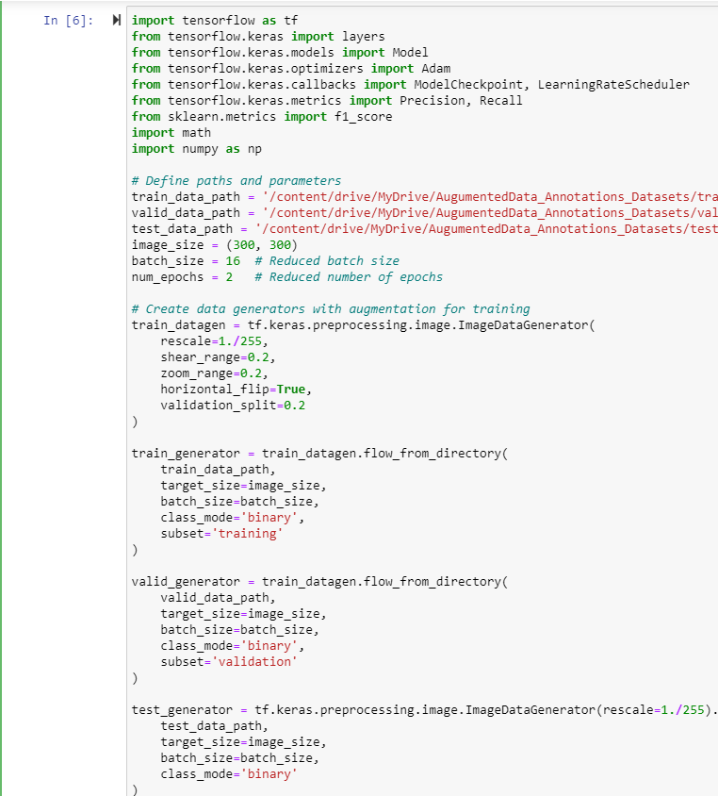
Notebook Demo

Slide 10

Conclusion
Project Impact:
It emphasizes the importance of everyone's role in mitigating the environmental impact of electronic waste. It's a motivational prompt, encouraging the audience to actively participate in sustainable practices and responsible waste management.
Future Opportunities:
Identification of areas for model improvement and expansion.
Call to Action:
Encouragement for adopting responsible e-waste disposal practices

Slide 11
References
Zhou et al., "A machine learning framework for the classification of e-waste," IEEE MIT Undergraduate Research Technology Conference (URTC), 2022.
Aishwarya et al., "A waste management technique to detect and separate non-biodegradable waste using machine learning and YOLO algorithm," 11th International Conference on Cloud Computing, Data Science & Engineering (Confluence), 2021.
Naushin et al., "Deep learning approach to deal with e-waste," Advanced Machine Intelligence and Signal Processing, 2022.
Nowakowski and Pamuła, "Application of deep learning object classifier to improve e-waste collection planning," Waste Management, 2020.
Babu et al., "Electrical and electronic waste: a global environmental problem," Waste Management & Research, 2007.
Li et al., "E-waste management using machine learning," Proceedings of the 6th International Conference on Big Data and Computing, 2021.
Shaikh et al., "Waste profiling and analysis using machine learning," Second International Conference on Inventive Research in Computing Applications (ICIRCA), 2020.
Rene et al., "Electronic waste generation, recycling, and resource recovery: Technological perspectives and trends," Journal of Hazardous Materials, 2021.
Sharma and Kumar, "Sustainable collection and classification of e-waste: A proposed computer vision technology-based framework," Available at SSRN, 2022.
Forti et al., "The global e-waste monitor 2020: Quantities, flows and the circular economy potential," 2020.

Slide 12

Thank You

